Slide 1
Basic repository setup for reproducible workflows

Slide 2
Resources
Liz Carter’s paper on GRRIEn (‘green’; Generalizable, Reproducible, Robust, & Interpreted Environmental analysis framework)
Carter, E., Hultquist, C., & Wen, T. (2023). GRRIEn Analysis: A Data Science Cheat Sheet for Earth Scientists Learning from Global Earth Observations. Artificial Intelligence for the Earth Systems, 2(2), 220065. https://doi.org/10.1175/AIES-D-22-0065.1
Rohini’s blog post on same:
Introducing the GRRIEn Analysis Framework: Defining standards for reproducible and robust supervised learning of earth surface processes at large spatial scales – Water Programming: A Collaborative Research Blog (wordpress.com)
Trevor’s blog post on structuring a Python project; a little more software develop-y in nature:
Structuring a Python Project: Recommendations and a Template Example – Water Programming: A Collaborative Research Blog (wordpress.com)

Slide 3
Overview
Using the GRRIEn repository template as a basic guide to setup a ‘standard’ repository structure for reproducible work
Note, the other elements of GRRIEn are highly useful and worth reading through, but will not be discussed today
There are many possible ways to do Reproducibility; this is one
Focus on key elements needed for a journal publication, not necessarily a software package
Discuss coding best practices
Discuss a basic example to support a manuscript (Zach)
More detailed example supporting a software level effort for Stochastic Weather Generator (Nasser)

Slide 4
Reproducible
The term “reproducibility” is usually defined as obtaining the same results when others use the same datasets and methods of the original study. As outlined in the literature (National Academies of Sciences, Engineering, and Medicine 2018), reproducibility in research is often referred to as computational reproducibility: can another scientist understand your method sufficiently to replicate data processing, model building, and validation in their computational environment? (Carter et al., 2023)
Facilitates easy replication of data acquisition, engineering, model training, and model evaluation, all of which can be published on a platform like GitHub alongside peer-reviewed publication of your results.

Slide 6
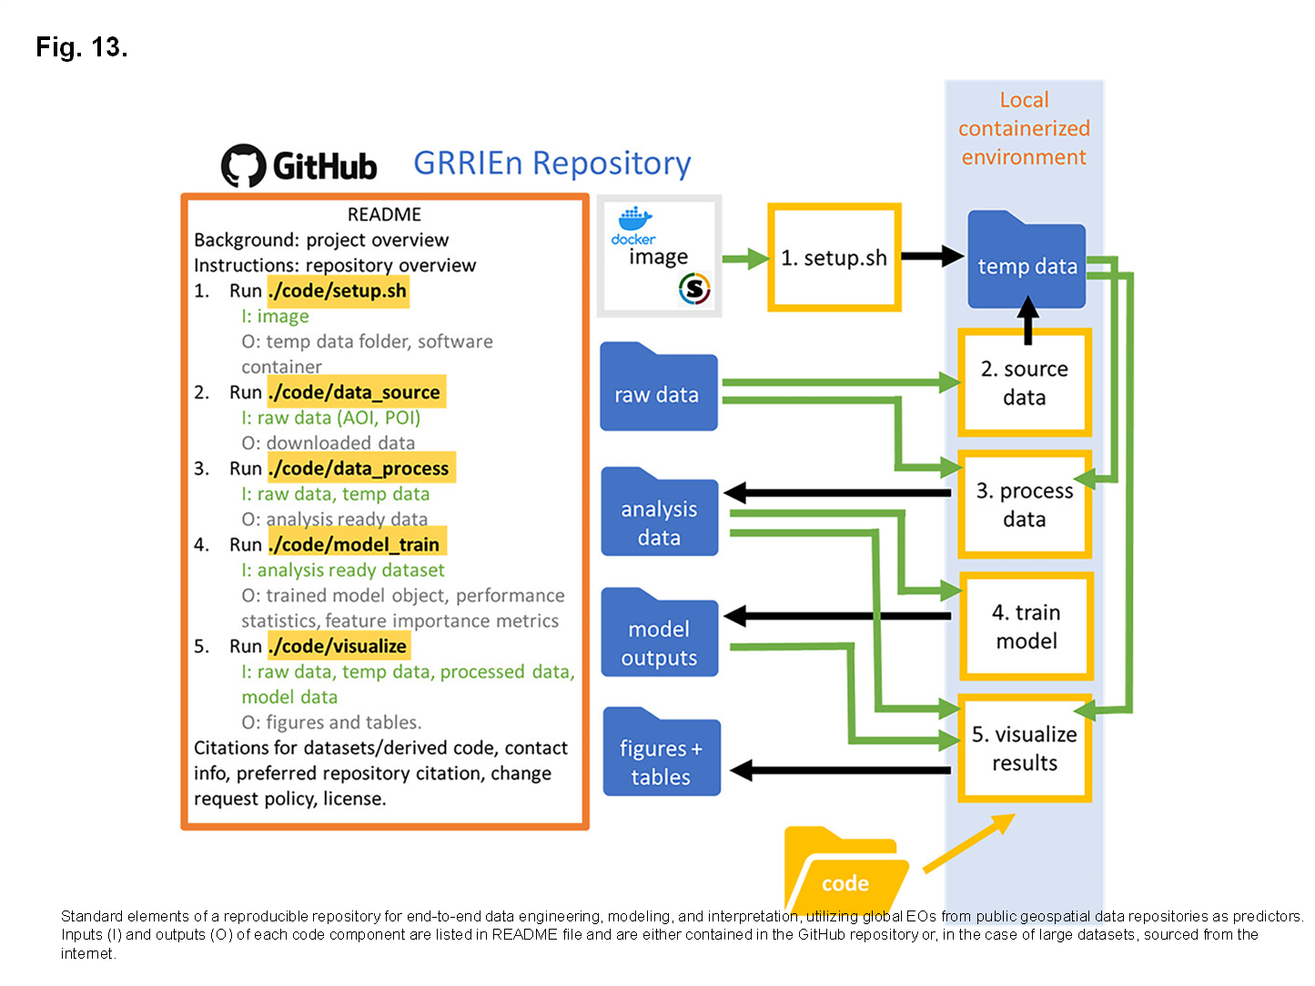
GRRIEn repo elements:
README file
a document providing detailed instructions on how to use elements of the repository for end-to-end analysis, the hardware and software required, the process for submitting merge requests, and license
Should also include:
Project overview
Repo overview (i.e. description above)
Citations for datasets/derived code
Contact info for repo owner
Preferred repo citation
Change request policy
License (GNU general public license (GPL-3.0) or MIT licenses are common; these may be added directly through GitHub)

Slide 7
GRRIEn repo elements:
setup.sh
bash script that initiates software image, installing all version-controlled software, libraries, and packages required by repository scripts, and creates a temporary data folder (temp data) in the user’s local environment. By providing required software, the setup.sh script ensures the portability of the workflow.
‘Debian Linux–compatible software image (file) is a container image is a static file that includes executable code that will initiate an instance in the local compute environment containing all version-controlled software, system libraries, and system tools to execute all code in a repository.’
Somewhat advanced, a simpler derivative of this might be to have a ‘requirements.txt’ document specifying package versions if they matter to the results

Slide 8
GRRIEn repo elements:
Raw data folder
contains the raw, unprocessed data, e.g. from public data repos, other studies, etc.
Note: The GRRIEn example is targeted to operations where data is stored in publically available external repos (i.e. the cloud). Thus, the raw data is just basic info (e.g. geographical area delimiters) to enable the ‘data_source’ code.
Note: For other types of studies where datasets are small or stored specific to the study, the raw data folder may include the raw data itself or instructions on how to pull it from a repo (e.g. Zenodo).

Slide 9
GRRIEn repo elements:
Analysis-ready data folder
Data that has been pre-processed in some way via the ‘data_process’ script and is often stored in some form of data frame, matrix, or array, for instance an R data structure (.rds) or Numpy array (.npz)
Note: This data may feature in visualizations, so this sub-repo interfaces with both model training and visualization code

Slide 10
GRRIEn repo elements:
Model outputs folder
trained model objects that can be called to make predictions, surrogate models used for model explanation as well as any data objects describing model fit and stability
In short, if you are employing some form of model to the pre-processed data, the outputs should go here, where they can be accessed for the final visualization step

Slide 11
GRRIEn repo elements:
Figures and tables folder
contains graphical and tabular representations of results, including graphs, figures, maps, and tables in open-source file formats (e.g. jpg, png, pdf, etc.)
Note: For a later data visualization discussion, try to incorporate elements required for a ‘manuscript-ready’ figure (e.g. titles, panel labels, etc) into the plotting sub-routines. Adding them later is not a good strategy (I know from personal experience) and most importantly, substantially reduces figure quality.

Slide 12
GRRIEn repo elements:
Code folder
is all scripts used to interact with the other files and elements in the repository.
Labeling as ‘src’ folder is common too
Note: ‘code’ or ‘src’ repository will very likely contain many more pieces of code than simply the ‘setup.sh’, ‘data_source’, ‘data_process’, ‘model_train’, and ‘visualize’ main scripts. These might be helper functions, subroutines, etc.

Slide 13
A possible GRRIEn repo structure
README
raw_data
meta_data
out
figs
src

Slide 14
A possible GRRIEn repo structure
README
Might Include
descriptions of study area for data sourcing
raw data files (netCDF, .csv, .txt, etc)
metadata from other studies, previous work, etc
…or possibly
raw_data
data
If dataset is not large or is archived in more of a meta-data format
meta_data
processed data files
metadata from other studies, previous work, etc
model output data
model objects (e.g. optimized parameter files)
may include sub-repos for fit/simulate, train/test, etc
out
labeled figure output files
tables
may include sub-repos for organization
figs
Main ‘driver’ scripts, e.g. ‘data_process’, ‘model_train’, etc
sub-routine scripts
helper function scripts
src

Slide 15
Coding practices
An extensive discussion of this topic is a useful future topic
Basic gist: Target the repo to a naïve user who simply wants to run the script with a basic understanding of what each element accomplishes
Good README file
Main scripts that run a series of subroutines or functions
Good code documentation throughout main scripts and subroutines/functions
Best practice in coding; use math and vectorization where possible, limit nested operations (for loops inside of for loops); methodical indentation of code (R is somewhat agnostic to this, Python is not)

Slide 16
Final thoughts
Trying to start from day 1 of a study with a good repo organization structure, git/GitHub functionality, ‘comment-as-you-go’ is a useful aspiration (for me too!) and makes life easier for manuscript submission, collaboration, etc.
Lots of examples, alternate approaches, and really nifty stuff out there, explore the space if you have time
We’ll take a look at some examples now and discuss good or bad practices therein:
https://github.com/zpb4/Nonstationary-SWM
Nasser’s SWG repo
Will revisit repo structure and coding practices in next week’s non-stationary SWM practical exercise

